Slide 1
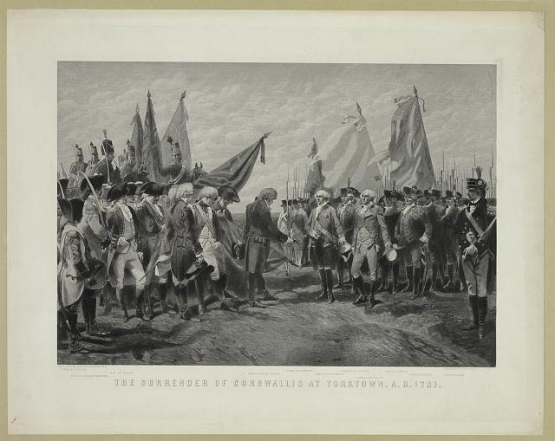

Slide 2
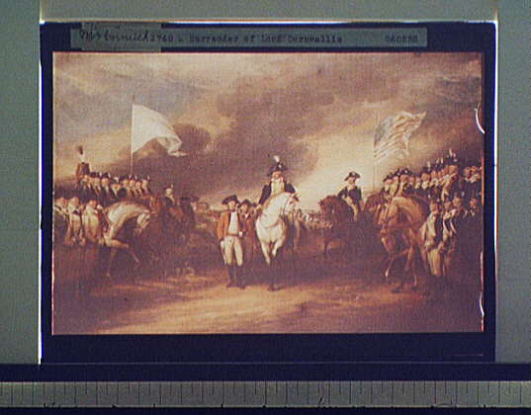

Slide 4
This powerpoint was kindly donated to
www.worldofteaching.com
http://www.worldofteaching.com
Is home to well over a thousand powerpoints submitted by teachers. This a free site. Please visit and I hope it will help in your teaching
Notes:
4

